Slide 1

Bigmart Sales Prediction
BCIS 5140 – Fall 2020
Team 6
Team Members:
Hamza Ahmed
Lakshmi Sunanda Nagareddygari
Sai Chaitanya Bondada
Suhail Ehsan Ul Bari

Slide 2
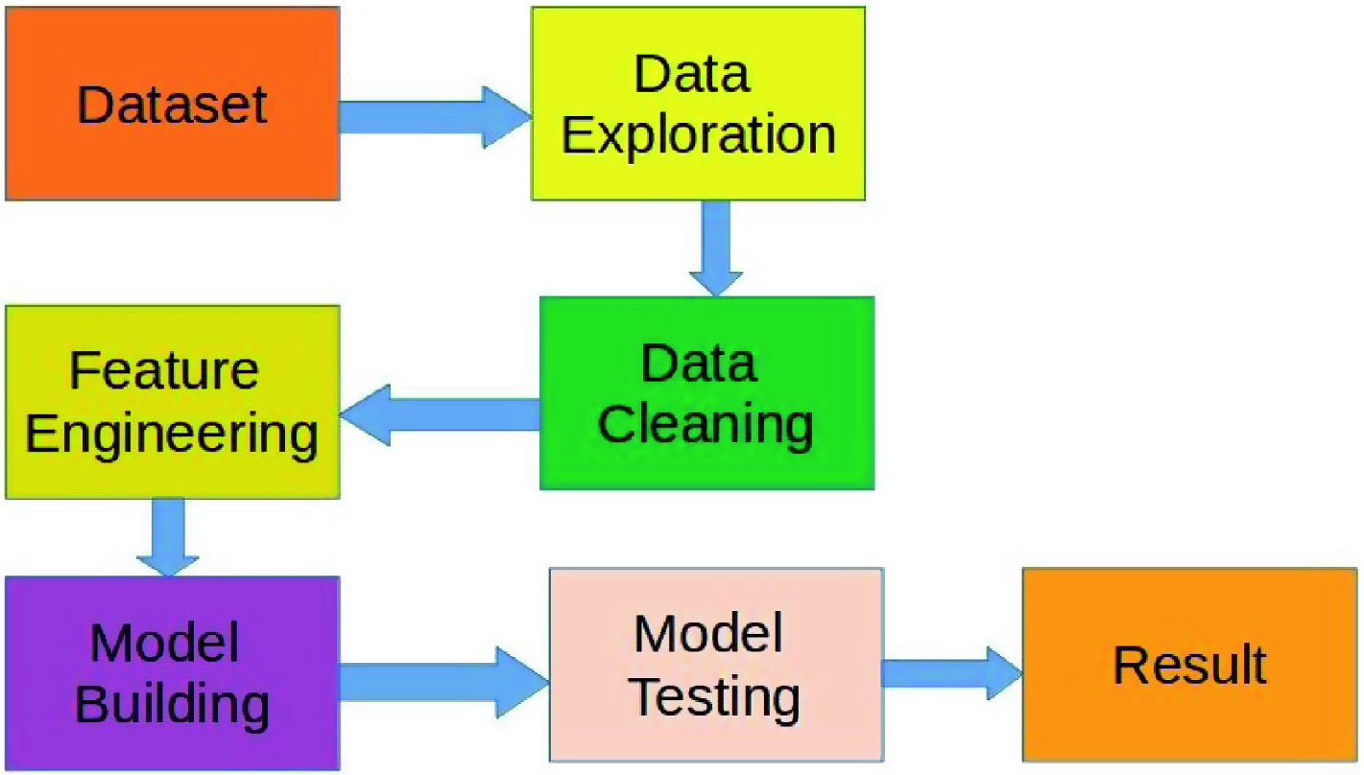
CONTENT
The Problem
Impact
Value Generation
The general approach
Hypothesis Generation
Data Exploration
Data Cleaning
Feature Engineering
Model building
Takeaways

Slide 3
THE PROBLEM
PROBLEM STATEMENT
The data scientists at BigMart have gathered 2013 sales data for 1559 items across 10 stores in various cities. Also, certain attributes for every item and store have been defined. The aim is to build a predictive model and find out the sales of every item at a specific store. Using this model, BigMart will try to understand the properties of products and stores which play a vital role in expanding sales.
VALUE GENERATION
Sales data prediction will help the company determine assured revenue over the coming few months which will help in budgeting for multiple departments and in inventory management. It will also help decide a company’s investment into newer market trends/ products and customer retention.

Slide 4
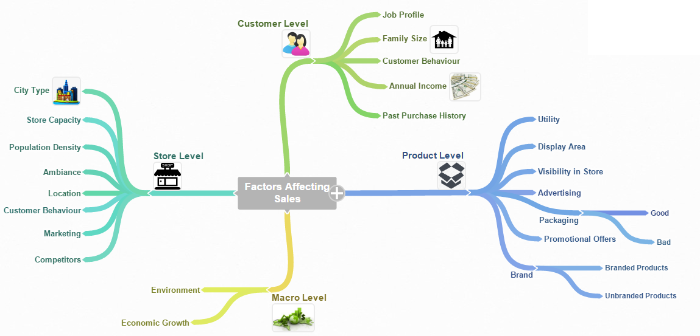
STORE LEVEL HYPOTHESES:
a) City Type
b) Population Density
c) Store Capacity
d) Competitors
e) Marketing
f) Location
g) Customer Behavior
h) Ambiance
2. PRODUCT LEVEL HYPOTHESES:
a) Brand
b) Packaging
c) Utility
d) Display Area
e) Visibility in Store
f) Advertising
g) Promotional Offers
HYPOTHESES GENERATION
Source : Analytics Vidhya

Slide 5
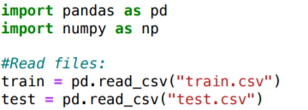
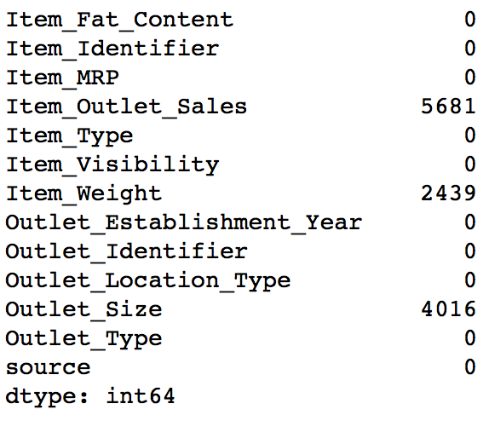
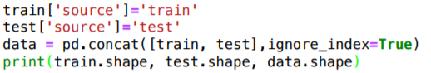
Importing the data

Slide 6
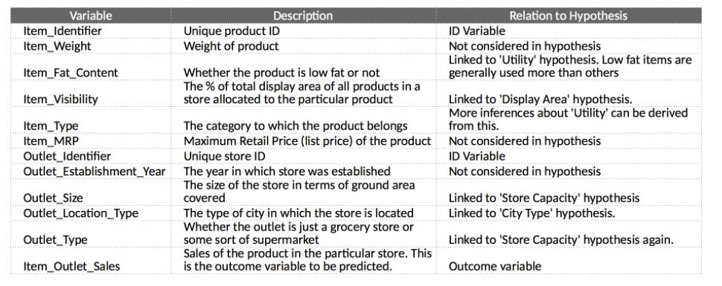
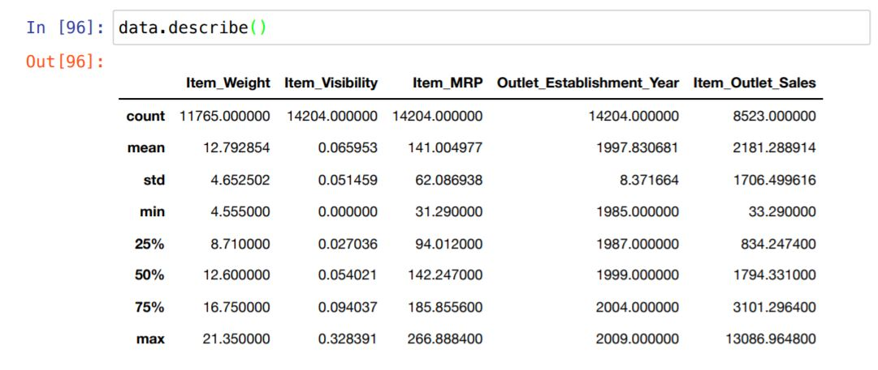
The variables being considered are:
DATA EXPLORATION
The summary statistics are:

Slide 7
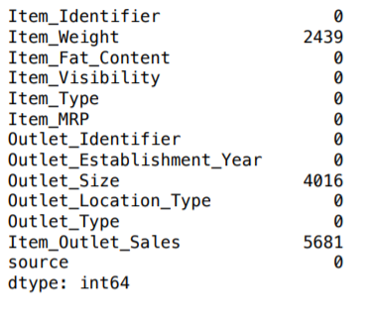
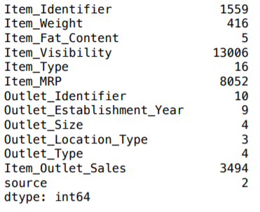
Finding Attributes which consists of Missing Values:
Results:
DATA CLEANING
Code:
Finding Attributes which consists of Unique Values:
Results:
From this we can observe that if there are lesser number of unique values which defines a categorical variable

Slide 8
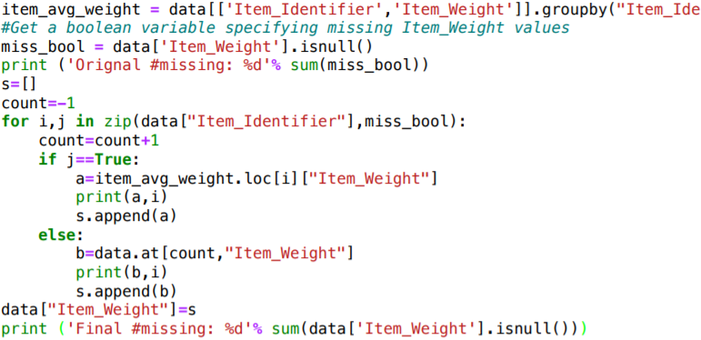
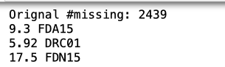
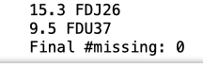
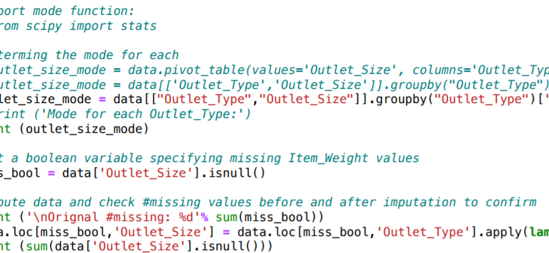
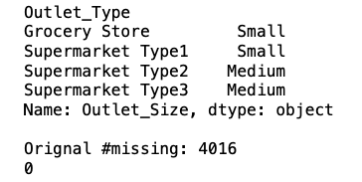
Using mean value we can replace the missing values of the attribute Item_Weight by grouping the products on the attribute Item_Identifier
DATA CLEANING
AND
FEATURE ENGINEERING
As the attribute Outlet_Size is a categorical variable we replace the
missing values using mode.

Slide 9
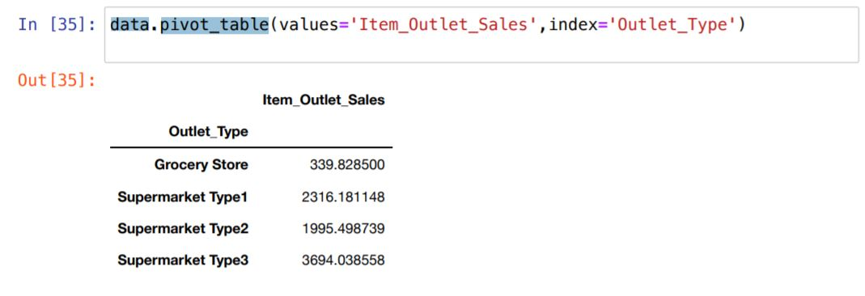
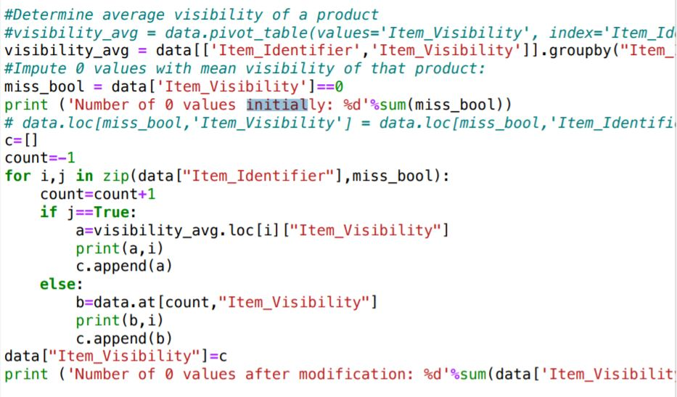
DATA CLEANING
AND
FEATURE ENGINEERING
In the code above, we explore whether we can combine supermarket types. However, since the sales difference is high, we keep them the same.
We try to impute missing values for item_visibility above

Slide 10
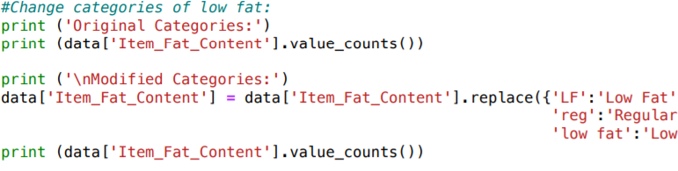
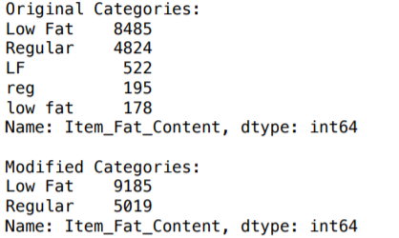
We can find that for the attribute Item_Fat_Content there
are various names for same column which leads to
wrong prediction. To solve the problem we used the below code
to modify the category.
Addressing Drawbacks
in the Data

Slide 11
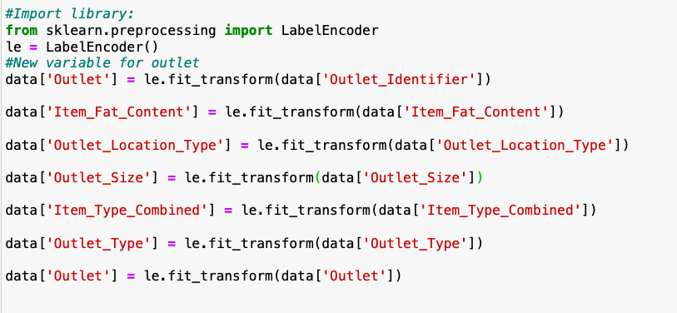
DATA CLEANING
AND
FEATURE ENGINEERING

Slide 12
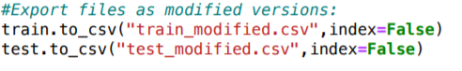
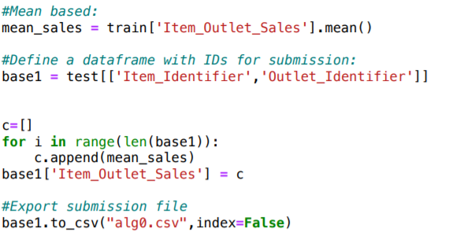
Exporting the modified data to CSV files

Slide 13
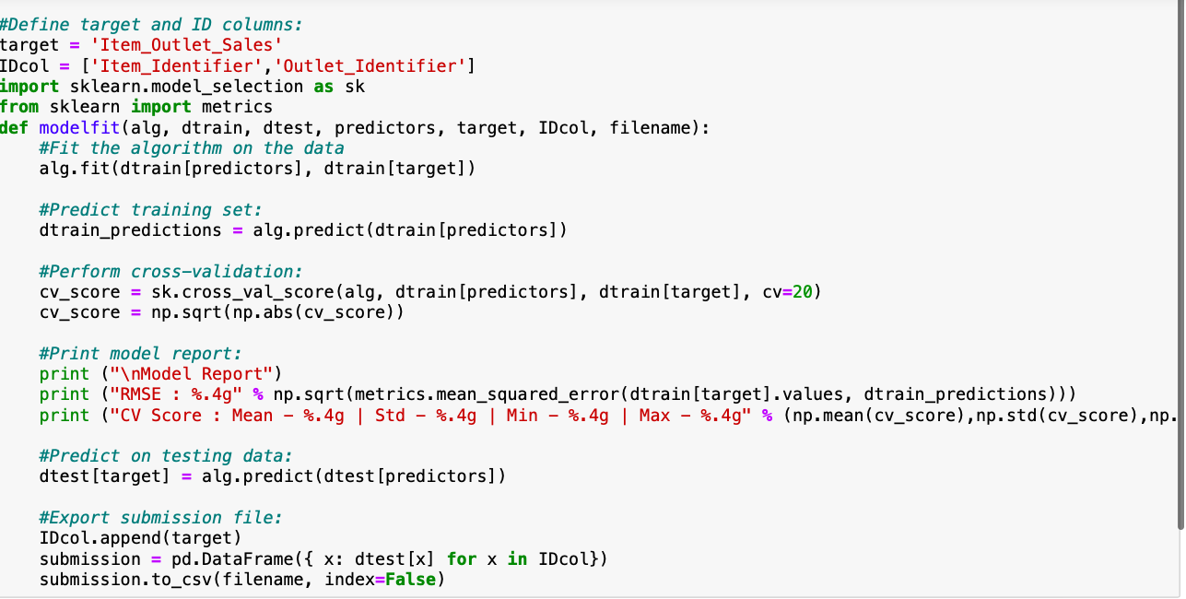
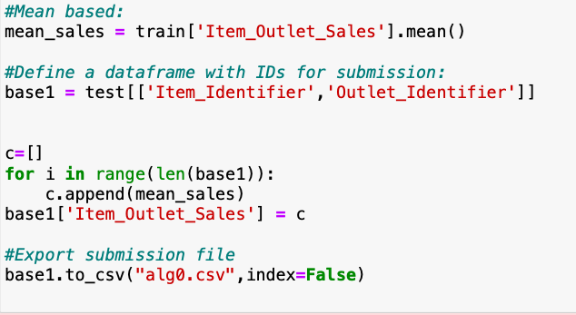
MODEL BUILDING
Baseline Model:

Slide 14
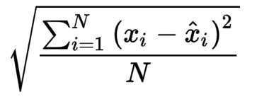
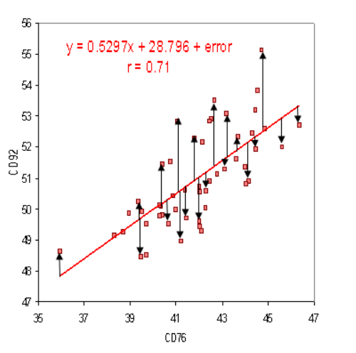
MODEL BUILDING
Criteria for Model Selection:
RMSE: It is the standard deviation of the prediction errors.

Slide 15
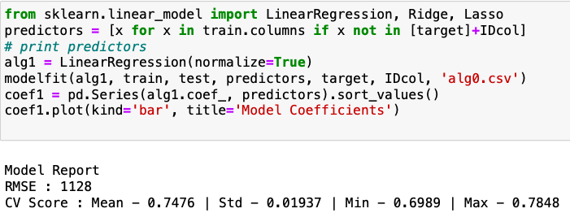
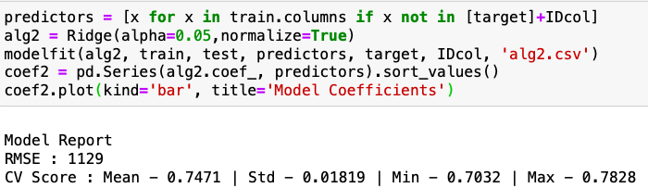
Linear Regression Model:
MODEL BUILDING
Ridge Regression Model:

Slide 16
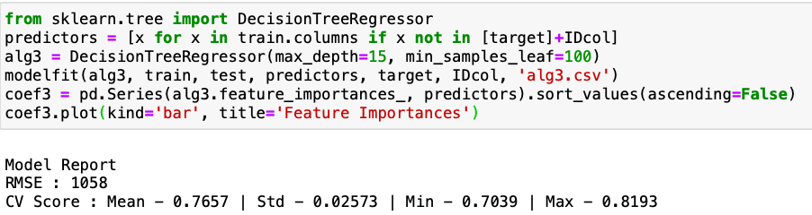
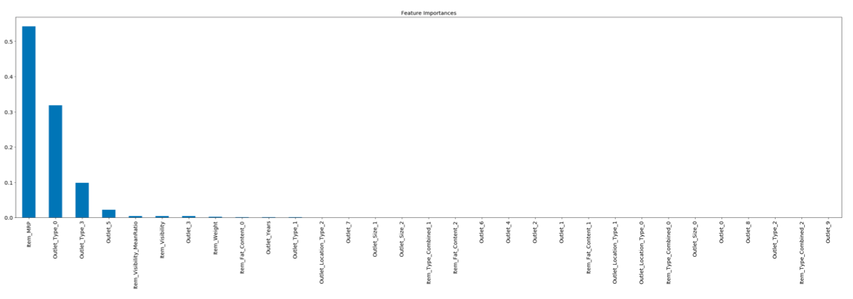
Decision Tree Model:
MODEL BUILDING

Slide 17
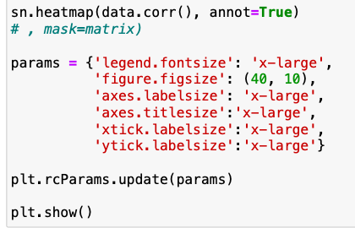
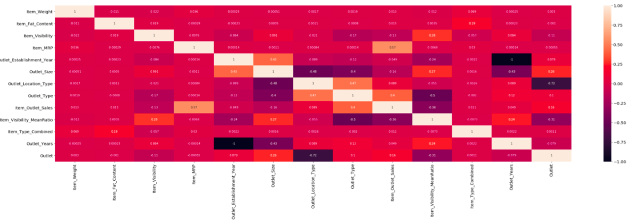
VISUALIZATIONS

Slide 18
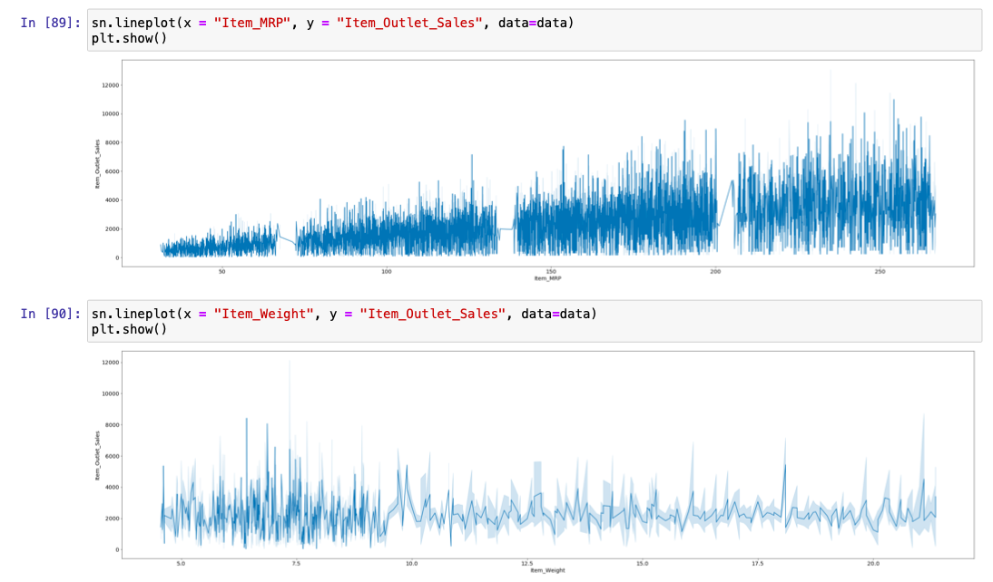
VISUALIZATIONS

Slide 19
TAKEAWAYS
Inventory Management
Item Visibility
Determining the layout of the outlet
Location
Population Density

Slide 20
Sources: https://www.analyticsvidhya.com/blog/2016/02/bigmart-sales-solution-top-20/
Thank you!!

